Slide 1
MUSHARRAF’S ERA (1999-2008)
4TH MARTIAL LAW IN PAKISTAN

Slide 2
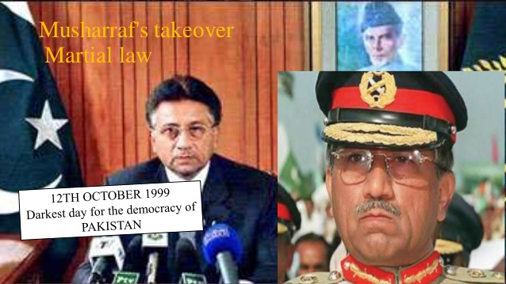

Slide 3

MEET MUSHARRAF’S EARLY LIFE
Born in Delhi on 11-Aug-1943
Son of Syed Musharraf and his wife Zarin Musharraf
After partition 1947, migrated towards Karachi
In 1949 Musharraf Family moved to Ankara
In 1956, left Turkey and returned to Pakistan
Attended Saint Patrick’s School
Studied Math from Forman Christian College in Lahore and later studied from Royal College of Defense
Entered the Pakistan Military Academy in 1961
In 1961, at the age of 18, Commissioned in the Pakistan Army
In 1964, got Bachelors degree from PMA
Fought in Indo-Pak war in 1965, as a young officer.
On 28 December 1968,married to Sehba Musharraf.
In 1974, assigned as lieutenant Colonel and colonel in 1978
In 1980, Commanded as artillery brigade
In 1990, promoted to Major General

Slide 4
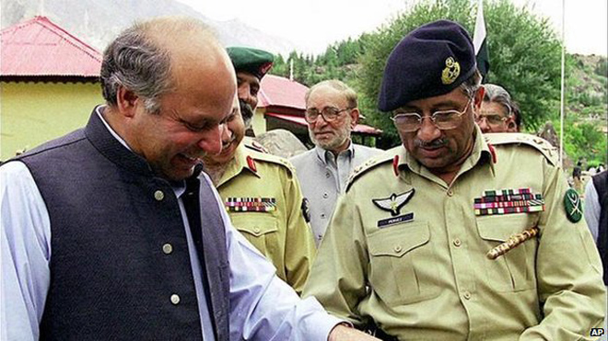
APPOINTMENT AS COAS
Nawaz Sharif decided to appoint a new COAS as problem arose between Nawaz and general Karamat.
Three lieutenant General Offices were In line to succeed
Lieutenant General Ali Kuli Khan
Lieutenant General Khalid Nawaz Khan
Lieutenant General Pervaiz Musharraf
Recommendation from Shahbaz Sharif and Nisar Chaudary
Nawaz personally promoted Musharraf to the four star and replaced Karamat.

Slide 5
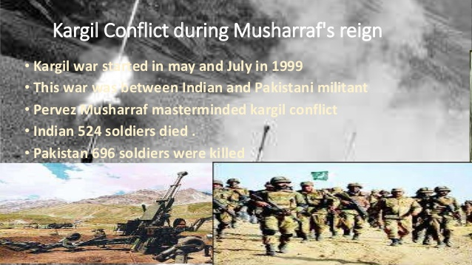

Slide 6
PERVAIZ VS NAWAZ!!(12-OCT-1999)
Musharraf return from official visit from Srilanka on account of celebration of 50 Years of Srilankan’s Army.
Nawaz Ordered not to allow Musharraf to land in territory of Pakistan
Nawaz announced replacing Musharraf with Khawaja Ziauddin
Karachi-bound Pakistan International Airlines PK805
leaving at 15:45 local time.
circling the Karachi Airport almost 200 minutes.
land at about 19:47 just before ran out of fuel.
At 22:30 the news came of imposing of martial law.

Slide 7
4TH MARTAL LAW IMPOSED IN PAKISTAN
12 October 1999 was the important day in the history of Pakistan. It was the darkest day for the democracy of Pakistan. This was the day; Musharraf took the charge of the country by enforcing Martial Law and ruled out the democracy. Imposing Martial Law is treason and violation of Article 6 of 1973 Constitution of Pakistan. This was all due to the hide and seek between that times Government and Army.

Slide 8
GENERAL ELECTIONS AND REFERENDUM
Pakistan came under military rule again on October 12, 1999.
General elections were held on October 10, 2002.
A referendum was held on April 30, 2002 for him to be elected as the president for another five years.
On November 12, 2007, Musharraf issued some amendments to the Military Act, which gave the armed forces some additional powers.

Slide 9
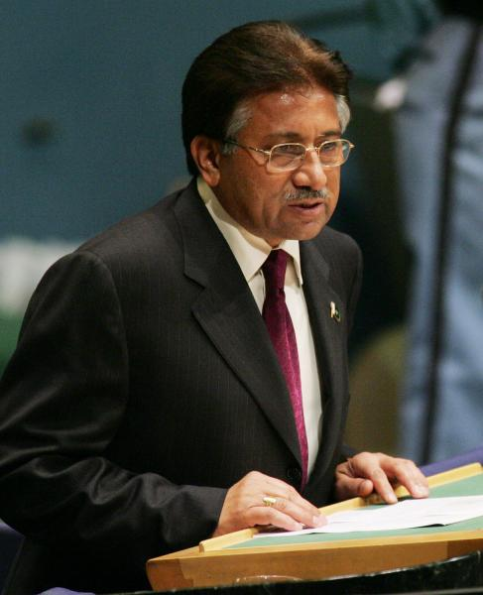
Musharraf’s Era
He took control on 1999.
General elections 2002 (10 oct)
Mir Zaffarullah Khan (2002-2004), as Prime Minister
Shaukat Aziz (28 oct 2004)

Slide 10
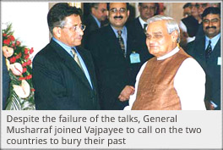
ACTIONS BY MUSHARRAF
Exaltation of Prime minister
Suspension and reinstallment of chief justice
(CHAUDRY IFTIKHAR)
Constitutional changes
Support of US war on Terror
Lal Masjid Operation
Return of Nawaz Sharif and Benazir Bhutto
Introduction of NAB
National reconciliation Ordinance
Shared views on Pakistani police commandos

Slide 11
EXILATION OF NAWAZ SHARIF
plane conspiracy.
Charges of hijacking, kidnapping and attempt to murder.
200 passengers.
Nawaz exiled for by the military on agreement to stay out of politics for 21 years.

Slide 12
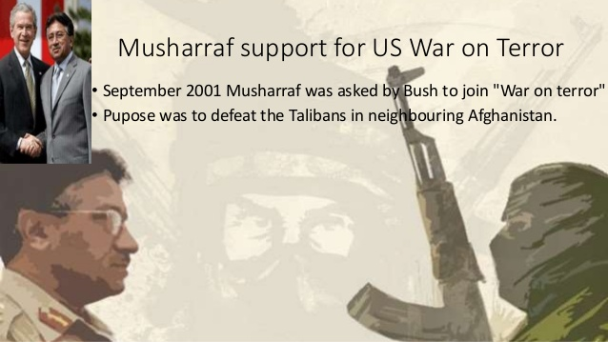

Slide 13
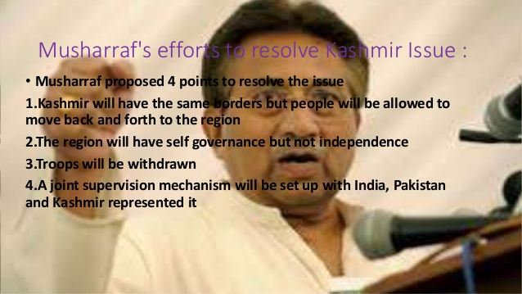

Slide 14
EVENTS HELD IN Musharraf’s ERA
Referendum 2001
Legal Framework order 2002
General elections 2002
Seventeenth Amendment to the Constitution of Pakistan
Lal Masjid Operation
Major Reforms and Achievements
Return of Nawaz Sharif and Benazir Bhutto
Introduction of NAB
National reconciliation Ordinance

Slide 15
Legal Framework Order, 2002
The Legal Framework Order, 2002 was issued by Pakistani president Pervez Musharraf in August 2002. It provided for the general elections of 2002 and the revival of the 1973 Constitution of Pakistan, and added numerous amendments to the Constitution. The following month, the Supreme Court overruled Musharraf, ruling that the amendments would have to be ratified by Parliament in the manner provided in the unamended 1973 Constitution—the amendments would have to be approved by two-thirds of both houses of the bicameral body.
After the October 2002 general elections, although Musharraf's supporters had a majority in Parliament, they did not have the required two-thirds supermajority to ratify the Legal Framework Order. Parliament was effectively deadlocked by strident opposition from Musharraf's opponents for over a year. In December 2003, a faction was persuaded to vote for a compromise amendment bill, the Seventeenth Amendment to the Constitution of Pakistan. With this amendment, parts of the Legal Framework Order were incorporated into the Constitution.

Slide 16
Seventeenth Amendment to the Constitution of Pakistan
The Seventeenth Amendment to the Constitution of Pakistan was an amendment to the Constitution of Pakistan passed in December 2003, after over a year of political wrangling between supporters and opponents of Pakistani President Pervez Musharraf.
This amendment made many changes to Pakistan's constitution. Many of these changes dealt with the office of the president and the reversal of the effects of the Thirteenth Amendment.
Article 63(1)(d) of the Constitution to become operative after December 31, 2004. The intent of this was to prohibit a person from holding both a political office.
Should the President win a majority in a vote of confidence in the electoral college within 30 days of the passage of this amendment, he shall be deemed to be elected to the office of President. (On January 1, 2004, Musharraf won 658 out of 1,170 electoral-college votes - a 56% majority - and was thereby deemed to be elected president.
The President regains the authority to dissolve the National Assembly - and thus effectively to dismiss the Pakistani Prime Minister - but the power to do so is made subject to an approval or veto by the Supreme Court of Pakistan.

Slide 17
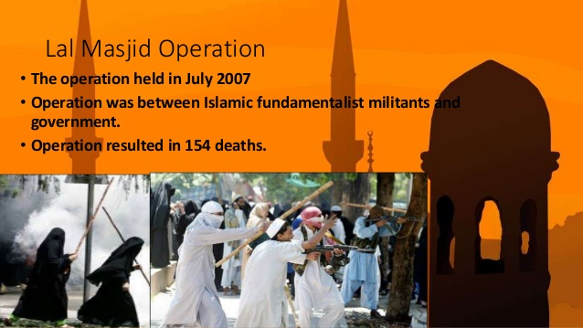

Slide 18
Major Reforms and Achievements:
Educational institutes. (31 public and 9 world class).
Literacy rate in Pakistan had increased from 45% (in 2002) to 53% (in 2005).
3rd Fastest growing economy after China and India.
A historic 100% increase in tax collection (amounting to Rs. 1 trillion) was observed.
The industrial sector registered 26 percent growth.
Seven motorways were completed or were under construction.
Gwadar, an advanced sea port, was developed.

Slide 19
Major Reforms and Achievements:
A historic 100% increase in tax collection (amounting to Rs. 1 trillion) was observed.
Five dams were built: Mirani, Subakzai, Gomalzam, Khurram and Tangi.
Progress was on its peak at that time. He started a plenty of new projects for the development of the Pakistan. He started tax free industrialization to urge the foreign investors. His plan worked and a number of multi-national companies launched in his era. The impact of that was the increasing number of jobs in his era.

Slide 20
RESIGNATION FROM MILITARY
On 2 October 2007 Military Resigned
Nov,3 Musharraf declared Emergency rule across Pakistan
Again fired Chief Justice and kept them under detention in their homes
Troops were deployed inside state run TV and Radio and
Musharraf appointed:
General Tariq Majid as chairman joint of Army staff
General Ashfaq Kayani as chief of Army staff
On 28 November 2007, Musharraf resigned.

Slide 21
End Of Musharraf’s Era
Return of Nawaz Sharif.
Return of Benazir.
Assassination of Benazir Bhutto on 27th December 2007.
Suicide attacks.
Many problem arose after Musharraf’s Era.

Slide 22
Conclusion:
The military, after the continuous eleven years rule of General Zia, had become enough sane not to meddle in the politics of Pakistan directly. The COAS General Aslam Beg was given the medal of democracy. The military, however, didn’t allow a free lunch to the inborn politicians. By this time, the terms such as controlled democracy and guided democracy were coined and put in practice. The rule of General Musharraf was, however, once again legalized on the basis of Doctrine of Necessity.

